Slide 1
Create a GUI in PowerShell
Module 10
Notes:
Version: 12/12/2019 17:20:43

Slide 2
Disclaimer

Slide 3
Agenda
Windows Presentation Framework
Introduction to Visual Studio
Creating a GUI
Integrating PowerShell Code with GUIs
Common issues

Slide 4
Windows Presentation Framework Introduction

Slide 5
Windows Presentation Framework
A standard set of editable GUI features
Used for application development and isn’t native to PowerShell
Part of the .NET framework, which can be leveraged by PowerShell
WPF GUIs are created using XAML, an XML based markup language

Slide 6
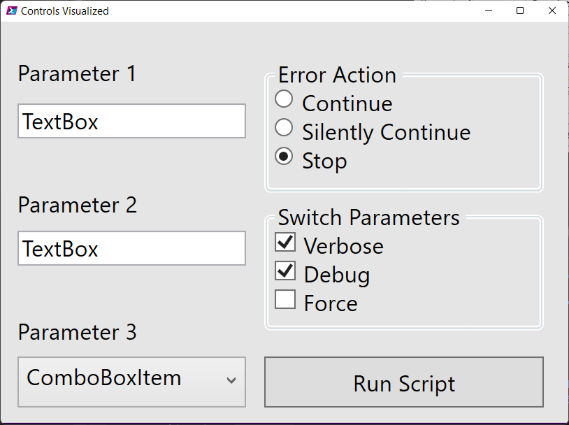
GUIs for PowerShell
Turn an existing tool into something more user friendly
Standard GUI controls can be used to gather input
WPF GUIs can adapt to screen resolutions and touch screens
Notes:
##### XAML CODE #####
<Window x:Name="Window" x:Class="WpfApplication1.Window1"
xmlns="http://schemas.microsoft.com/winfx/2006/xaml/presentation"
xmlns:x="http://schemas.microsoft.com/winfx/2006/xaml"
xmlns:d="http://schemas.microsoft.com/expression/blend/2008"
xmlns:mc="http://schemas.openxmlformats.org/markup-compatibility/2006"
xmlns:local="clr-namespace:WpfApplication1"
mc:Ignorable="d"
Title="Controls Visualized" Height="265" Width="375" Background="#FF340249" Padding="0,0,0,0" HorizontalAlignment="Left" VerticalAlignment="Top">
<Viewbox HorizontalAlignment="Left" VerticalAlignment="Top">
<Grid Background="#FFE5E5E5" Width="375" Height="265">
<TextBox x:Name="textBox" Height="23" Margin="11,54,0,0" TextWrapping="Wrap" Text="TextBox" VerticalAlignment="Top" HorizontalAlignment="Left" Width="151"/>
<Button x:Name="button" Content="Run Script" HorizontalAlignment="Left" Height="34" Margin="174,221,0,0" VerticalAlignment="Top" Width="185" Padding="1,1,1,1"/>
<ComboBox x:Name="comboBox" Margin="11,221,0,0" VerticalAlignment="Top" HorizontalAlignment="Left" Width="151" RenderTransformOrigin="0.5,0.5" Height="34">
<ComboBoxItem Content="ComboBoxItem" IsSelected="True"/>
<ComboBoxItem Content="ComboBoxItem"/>
<ComboBoxItem Content="ComboBoxItem"/>
</ComboBox>
<GroupBox Header="Error Action" HorizontalAlignment="Left" Margin="174,23,0,0" Width="185" VerticalAlignment="Top" Height="90">
<StackPanel>
<RadioButton x:Name="radioButton1" Content="Continue"/>
<RadioButton x:Name="radioButton2" Content="Silently Continue"/>
<RadioButton x:Name="radioButton3" Content="Stop"/>
</StackPanel>
</GroupBox>
<GroupBox Header="Switch Parameters" HorizontalAlignment="Left" Margin="174,117,0,0" Width="185" VerticalAlignment="Top" Height="87">
<StackPanel>
<CheckBox x:Name="Verbose" Content="Verbose"/>
<CheckBox x:Name="Debug" Content="Debug"/>
<CheckBox x:Name="Force" Content="Force"/>
</StackPanel>
</GroupBox>
<TextBlock HorizontalAlignment="Left" Margin="11,194,0,0" Text="Parameter 3" TextWrapping="Wrap" VerticalAlignment="Top"/>
<TextBlock HorizontalAlignment="Left" Margin="11,110,0,0" Text="Parameter 2" TextWrapping="Wrap" VerticalAlignment="Top"/>
<TextBlock HorizontalAlignment="Left" Margin="11,23,0,0" Text="Parameter 1" TextWrapping="Wrap" VerticalAlignment="Top"/>
<TextBox x:Name="textBox_Copy" Height="23" Margin="11,138,0,0" TextWrapping="Wrap" Text="TextBox" VerticalAlignment="Top" HorizontalAlignment="Left" Width="151"/>
</Grid>
</Viewbox>
</Window>
##### END XAML CODE #####

Slide 7

Questions?

Slide 8

Introduction to Visual Studio

Slide 9
Visual Studio for XAML
GUI editor for XAML code in real time
Drag and drop functionality for adding new controls
Install .NET desktop development feature for WPF XAML

Slide 10
Visual Studio 2022 Editions
Visual Studio Community
Free for non-enterprise, education, or open-source projects
Visual Studio Professional
Built for Enterprise use
Visual Studio Enterprise
Extra features unnecessary for WPF GUIs

Slide 11
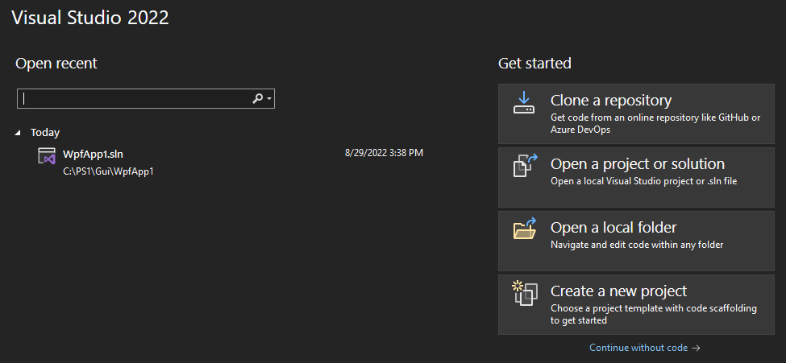

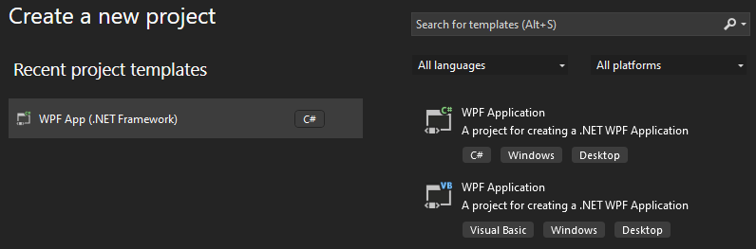
Creating a XAML project
Create a New Project
Select WPF App (Visual C#)
Notes:
Create a new WPF Application project in Visual Basic or Visual C# named ExpenseIt:
Open Visual Studio and select Create a new project under the Get started menu.
The Create a new project dialog opens.
In the Language dropdown, select either C# or Visual Basic.
Select the WPF App (.NET Framework) template and then select Next.
The Configure your new project dialog opens.
Enter the project name ExpenseIt and then select Create.
Configure a new project dialog
Visual Studio creates the project and opens the designer for the default application window named MainWindow.xaml.

Slide 12
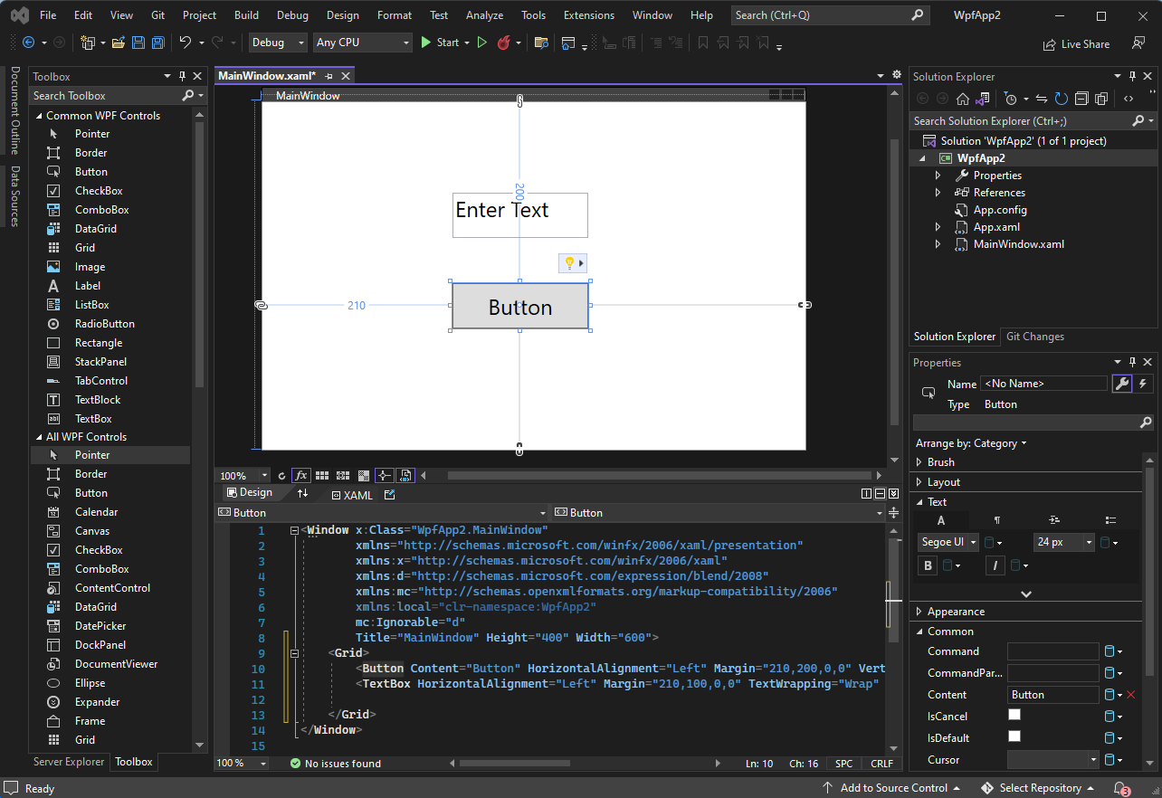
Visual Studio Layout
Solution Explorer
List of files in project
Use MainWindow.XAML
Viewport
Code editor
Visual GUI creator
Tabs for open files
Toolbox
Contains GUI controls
Drag & Drop
Properties
Edit GUI controls
Changes XAML code

Slide 13
Visual Studio Layout
Solution Explorer
List of files in project
Use MainWindow.XAML
Viewport
Code editor
Visual GUI creator
Tabs for open files
Toolbox
Contains GUI controls
Drag & Drop
Properties
Edit GUI controls
Changes XAML code

Slide 14

Demonstration
Visual Studio

Slide 15
Questions?

Slide 16

WPF Controls

Slide 17
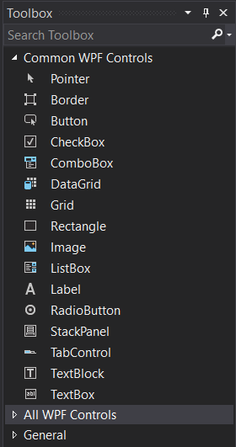
XAML Controls
Standardized GUI components
Located in the toolbox tab of Visual Studio
Around 50 available out of the box
Custom controls can be created or downloaded
Notes:
Free app to try controls and view code samples
https://www.microsoft.com/en-us/p/xaml-controls-gallery/9msvh128x2zt
Additional controls available via Nuget:
Microsoft.UI.Xaml.Controls
Additional controls for UWP development are available from companies such as Telerik, SyncFusion, DevExpress, Infragistics, ComponentOne, and ActiPro.

Slide 18
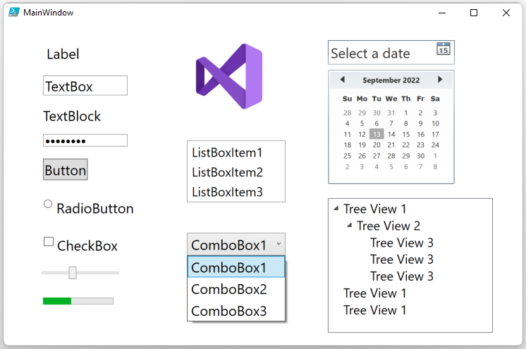
XAML Controls Visualized
Notes:
A good site to learn the controls and how they work
https://www.wpf-tutorial.com/
####### XAML CODE ######
<Window
xmlns="http://schemas.microsoft.com/winfx/2006/xaml/presentation"
xmlns:x="http://schemas.microsoft.com/winfx/2006/xaml"
xmlns:d="http://schemas.microsoft.com/expression/blend/2008"
xmlns:mc="http://schemas.openxmlformats.org/markup-compatibility/2006"
xmlns:local="clr-namespace:WpfApp2"
xmlns:System="clr-namespace:System;assembly=mscorlib" x:Class="WpfApp2.MainWindow"
mc:Ignorable="d"
Title="MainWindow" Height="480" Width="750">
<Grid>
<Button Content="Button" HorizontalAlignment="Left" Margin="56,193,0,0" VerticalAlignment="Top" FontSize="20"/>
<TextBox HorizontalAlignment="Left" Margin="56,75,0,0" TextWrapping="Wrap" Text="TextBox" VerticalAlignment="Top" Width="120" FontSize="20"/>
<CheckBox Content="CheckBox" HorizontalAlignment="Left" Margin="56,303,0,0" VerticalAlignment="Top" FontSize="20"/>
<RadioButton Content="RadioButton" HorizontalAlignment="Left" Margin="56,250,0,0" VerticalAlignment="Top" FontSize="20"/>
<ComboBox HorizontalAlignment="Left" Margin="260,298,0,0" VerticalAlignment="Top" Width="140" FontSize="20" SelectedIndex="1" IsDropDownOpen="True">
<ComboBoxItem Content="ComboBox1" IsSelected="True"/>
<ComboBoxItem Content="ComboBox2"/>
<ComboBoxItem Content="ComboBox3"/>
</ComboBox>
<DatePicker HorizontalAlignment="Left" Margin="460,25,0,0" VerticalAlignment="Top" FontSize="20" Width="180"/>
<PasswordBox HorizontalAlignment="Left" Margin="56,158,0,0" VerticalAlignment="Top" Width="120" Password="asdfasdf"/>
<ListBox Margin="260,167,0,0" HorizontalAlignment="Left" VerticalAlignment="Top" Width="140">
<ListBoxItem Content="ListBoxItem1" FontSize="18"/>
<ListBoxItem Content="ListBoxItem2" FontSize="18"/>
<ListBoxItem Content="ListBoxItem3" FontSize="18"/>
</ListBox>
<Slider HorizontalAlignment="Left" Margin="49,346,0,0" VerticalAlignment="Top" Width="120" Value="4"/>
<TextBlock HorizontalAlignment="Left" Margin="56,118,0,0" TextWrapping="Wrap" Text="TextBlock" VerticalAlignment="Top" FontSize="20"/>
<Label Content="Label" HorizontalAlignment="Left" Margin="56,25,0,0" VerticalAlignment="Top" FontSize="20"/>
<ProgressBar HorizontalAlignment="Left" Height="10" Margin="56,390,0,0" VerticalAlignment="Top" Width="100" Value="40"/>
<Image HorizontalAlignment="Left" Height="107" VerticalAlignment="Top" Width="164" Source="C:\ps1\Gui\WpfApp2\VS.png" Margin="238,25,0,0"/>
<TreeView Margin="460,249,0,0" HorizontalAlignment="Left" VerticalAlignment="Top" Width="234" Height="191" >
<TreeViewItem Header="Tree View 1" IsExpanded="True" FontSize="18">
<TreeViewItem Header="Tree View 2" IsExpanded="True" FontSize="18">
<TreeViewItem Header="Tree View 3" FontSize="18"/>
<TreeViewItem Header="Tree View 3" FontSize="18"/>
<TreeViewItem Header="Tree View 3" FontSize="18"/>
</TreeViewItem>
</TreeViewItem>
<TreeViewItem Header="Tree View 1" FontSize="18"/>
<TreeViewItem Header="Tree View 1" FontSize="18"/>
</TreeView>
<Calendar HorizontalAlignment="Left" Margin="450,64,0,0" VerticalAlignment="Top" Height="200" Width="200"/>
</Grid>
</Window>
##### End XAML Code #####

Slide 19
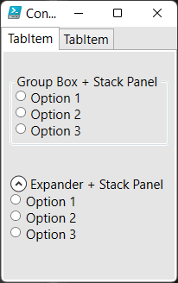
Grouping Controls
Every control must be in a group
Dock Panel – used to set anchor points for relative placement
Groups are used to organize and align controls
Tab controls – allows multiple tabs
Expander – expand/collapse areas of the GUI
WPF has many options including:
Ex. Radio buttons inside a group are linked
Grid (default) – uses XY coordinates, rows, and columns
Stack Panel – stacks child elements automatically within bounds
Group box – link controls together with header and border
Toolbar – contains buttons for commands (usually menus)
Statusbar – docked at the bottom to display status info
Menu – hierarchical information linked to commands (buttons)

Slide 20
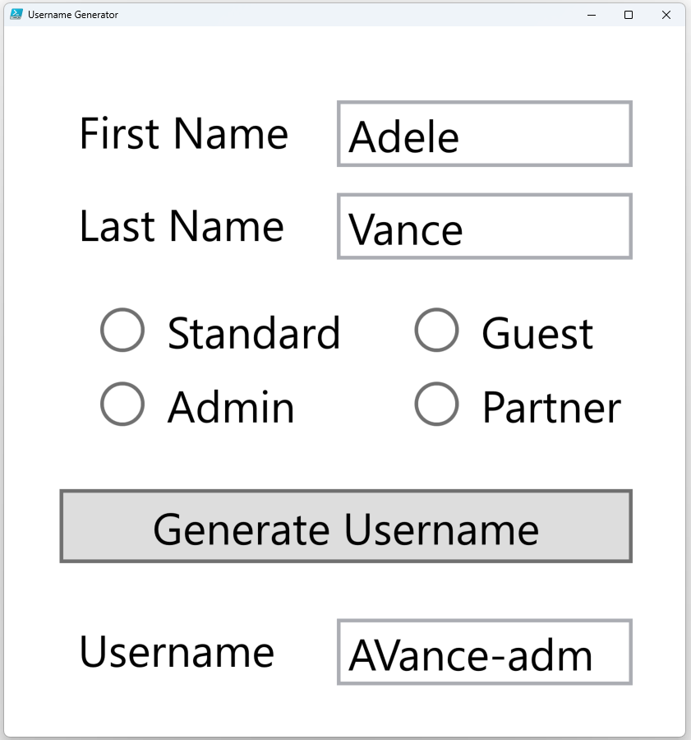
GUI Design Best Practices
Aim for clear, simple, intuitive GUIs
Minimize the number of GUI controls
Label inputs
Align controls
Leverage grouping
Distinct sections can be moved to tabs
Settings not needed all the time can be put in expanders
Pay attention to scaling
WPF has robust support for this, not covered in this workshop
Windows, images, etc

Slide 21
Demonstration
Simple WPF GUI

Slide 22
Demonstration
Basic GUI controls

Slide 23
Demonstration
Advanced / Grouping GUI controls

Slide 24
Questions?

Slide 25

Your first GUI

Slide 26
WPF / XAML GUI Workflow
Name all controls in Visual Studio to use in PowerShell
Only use .XAML files – ignore .CS files
Best practice: Mock-up the GUI before designing it in Visual Studio
Code to import XAML is mostly the same between projects
Design GUI
Import XAML into PowerShell
Write PowerShell code
Display GUI
Notes:
Only XAML files are used from Visual Studio
Name controls in XAML to easily use in PowerShell
Plan the GUI layout prior to creating in Visual Studio

Slide 27
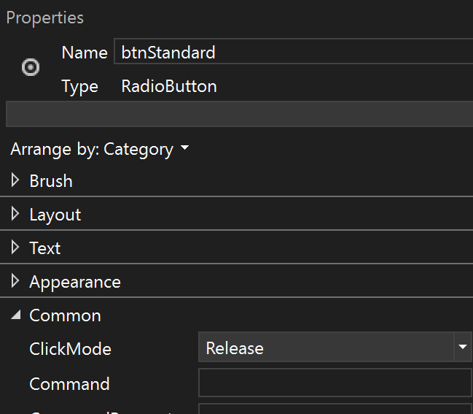
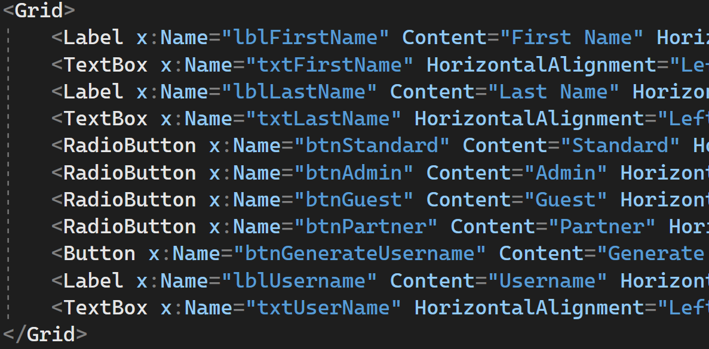
Naming WPF Controls
Name controls in the properties pane in Visual Studio
Names are stored in the XAML with the X:Name attribute
Only named controls can be used in the PowerShell code
Best practice: Use clear, descriptive names
Notes:
Only XAML files are used from Visual Studio
Name controls in XAML to easily use in PowerShell
Plan the GUI layout prior to creating in Visual Studio

Slide 28
Load XAML Into PowerShell
Creates a hash table named $GUI
Keys in the hash table match x:Names
Reusable code – no need to memorize
Values in hash table are the control objects
# Add WPF assemblies
Add-Type -AssemblyName PresentationCore, PresentationFramework
# Cleanup XAML options
$XAML= [XML](Get-Content -Path '$PSScriptRoot\MainWindow.xaml' -Raw)
$XAML.Window.RemoveAttribute('x:Class')
$XAML.Window.RemoveAttribute('xmlns:local')
$XAML.Window.RemoveAttribute('xmlns:d')
$XAML.Window.RemoveAttribute('xmlns:mc')
$XAML.Window.RemoveAttribute('mc:Ignorable')
# Read XML as XAML
$XAMLreader = New-Object System.Xml.XmlNodeReader $XAML
$Rawform = [Windows.Markup.XamlReader]::Load($XAMLreader)
Notes:
First, we add the assemblies needed to the runspace:
Add-Type -AssemblyName PresentationCore,PresentationFramework
Next, we remove the unwanted headers:
$XAML= [XML](Get-Content -Path '$PSScriptRoot\MainWindow.xaml' -Raw)
$XAML.Window.RemoveAttribute('x:Class')
$XAML.Window.RemoveAttribute('xmlns:local')
$XAML.Window.RemoveAttribute('xmlns:d')
$XAML.Window.RemoveAttribute('xmlns:mc')
$XAML.Window.RemoveAttribute('mc:Ignorable’)
We then read the XML as XAML – This is the Raw form we will be controlling
$XAMLreader = New-Object System.Xml.XmlNodeReader $XAML
$Rawform = [Windows.Markup.XamlReader]::Load($XAMLreader)

Slide 29
Creating $GUI Hash Table
PowerShell code goes before the $Rawform.ShowDialog()
# Add XML namespace manager
$XmlNamespaceManager =[System.Xml.XmlNamespaceManager]::New($XAML.NameTable)
$XmlNamespaceManager.AddNamespace(
'x’,'http://schemas.microsoft.com/winfx/2006/xaml')
# Create hash table containing a representation of all controls
$GUI = @{}
$NamedNodes = $XAML.SelectNodes("//*[@x:Name]",$XmlNamespaceManager)
$NamedNodes | ForEach {$GUI.Add($_.Name, $Rawform.FindName($_.Name))}
# PowerShell Code (Ex. populate combo boxes & link up buttons)
Foreach($Service in get-service) {$GUI["ComboBox"].Items.Add($Service.Name)}
$GUI["Button"].Add_Click({Get-Service $GUI["ComboBox"].SelectedItem})
# Show GUI
$Rawform.ShowDialog()
Notes:
to be able to select nodes using namespace x: we need to add a namespace manager to the XML
$XmlNamespaceManager = [System.Xml.XmlNamespaceManager]::New($XAML.NameTable)
$XmlNamespaceManager.AddNamespace('x','http://schemas.microsoft.com/winfx/2006/xaml')
To create an entry in the hash table referencing all x:Name controls we loop thru the XML code. This is why all controls in VS need to be named.
$GUI = @{}
$namedNodes = $XAML.SelectNodes("//*[@x:Name]",$XmlNamespaceManager)
$namedNodes | ForEach-Object -Process {$GUI.Add($_.Name, $Rawform.FindName($_.Name))}
Display the form to the end user
$Rawform.ShowDialog()

Slide 30
Demonstration
Dissecting MyFirstGUI

Slide 31
Questions?

Slide 32

Advanced GUI Design

Slide 33
Demonstration
Advanced GUI Design

Slide 34
Questions?

Slide 35

Code Behind a Form
Notes:
Show accessing properties
Ex. Textbox, combo box, check box
Intro events
Show linking events
Ex. Button click, combobox selection changed

Slide 36
Using Controls and Events
$GUI hash table allows access to control elements
Control properties gather user input
Control events trigger code blocks

Slide 37
Control Properties
Controls have properties, just like any other object
Every piece of information is an accessible property
The $GUI hash table is used to access the control objects
User input is stored into properties
Commonly used properties:
CheckBox IsChecked
ImageBox Source
TextBox Text
ComboBox SelectedItem, Items
$Service = get-service $GUI["ServiceComboBox"].SelectedItem
$Service = get-service $GUI["TextBox"].Text
Foreach($Service in get-service)
{
[void]$GUI["ServiceComboBox"].Items.Add($Service.Name)
}
$GUI["ImageBox"].source = "$PSScriptRoot\Yes.png"
Notes:
Controls are stored as hashtables
All control properties are accessed via hashtables
margins, appearance, text typed into the form, date selected, items in combobox

Slide 38
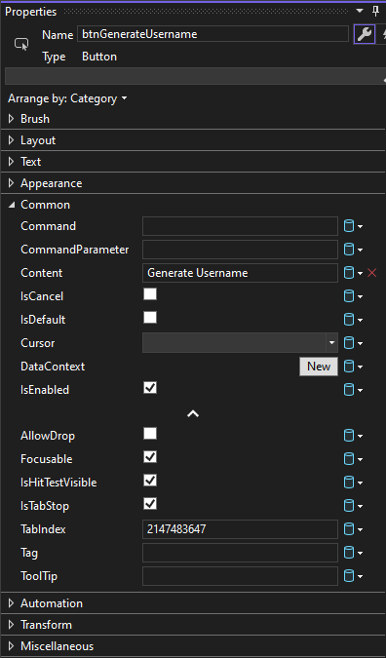
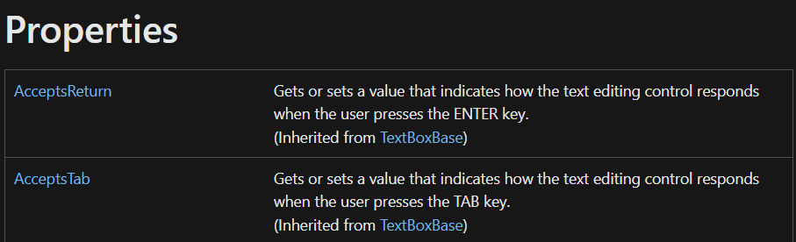
Finding Property Names
Properties can be found in multiple locations: Get-Member, Docs pages, or Visual Studio pane
$GUI[“MyTextBox"] | Get-Member
TypeName: System.Windows.Controls.TextBox
Name MemberType Definition
---- ---------- ----------
FontSize Property double FontSize {get;set;}
IsEnabled Property bool IsEnabled {get;set;}
Name Property string Name {get;set;}
Text Property string Text {get;set;}
Notes:
https://learn.microsoft.com/en-us/dotnet/api/system.windows.controls.textbox?view=windowsdesktop-7.0

Slide 39
Control Events
Events are a way for an object to broadcast that something has happened
PowerShell code can be triggered from these events
Code is stored in script blocks and added via methods
Method syntax is add_EVENTNAME(<scriptblock>)
Button add_Click()
Combobox add_SelectionChanged()
Slider add_ValueChanged()
$ComboSB = {
$service = get-service $GUI["ServiceComboBox"].SelectedItem
if($service.status -eq "running")
{$GUI["ImageBox"].Source = "$PSScriptRoot\running.png”}
else
{$GUI["ImageBox"].Source = "$PSScriptRoot\stopped.png"}
}
[void]$GUI["ServiceComboBox"].add_SelectionChanged($ComboSB)
Notes:
Controls are stored as hashtables
All control properties are accessed via hashtables
margins, appearance, text typed into the form, date selected, items in combobox

Slide 40
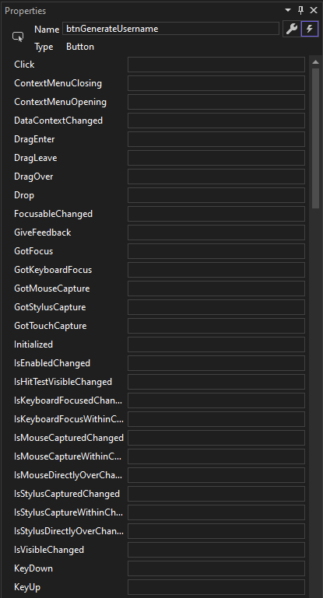
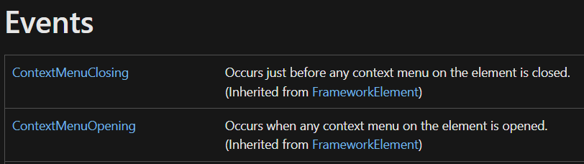
Finding Event Names
Events can be found in multiple locations: Get-Member, Docs pages, or Visual Studio pane
$GUI["ServiceComboBox"] |
Get-Member -MemberType Event | select name
Name
----
ContextMenuClosing
ContextMenuOpening
DataContextChanged
DragEnter
Notes:
https://learn.microsoft.com/en-us/dotnet/api/system.windows.controls.textbox?view=windowsdesktop-7.0

Slide 41
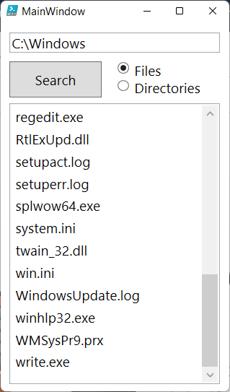
Example – Using Controls and Events
$ButtonSB = {
$GUI["DisplayListBox"].Items.Clear()
if(!(Test-Path $GUI["Path"].text))
{
$GUI["DisplayListBox"].Items.Add("INVALID PATH")
return
}
if($GUI["FileRadioButton"].isChecked)
{$data = Get-ChildItem -Path $GUI["Path"].text -file}
else
{$data = Get-ChildItem -Path $GUI["Path"].text -Directory}
foreach ($name in $data)
{
$GUI["DisplayListBox"].Items.add($name.Name)
}
}
$GUI["SearchButton"].Add_Click($ButtonSB)
Notes:
Note that running long code execution might be perceived by a user as a hanging / crashing form.

Slide 42
Demonstration
Code Behind a Form

Slide 43
Data Binding
A method to link a property of a control to another value to keep them in sync
Updating source value causes other controls to get updated automatically
Ways to declare data binding
Directly in XAML referencing another control as source
In PowerShell code referencing a PowerShell variable object
Used to improve visual experience and sync multiple input methods

Slide 44
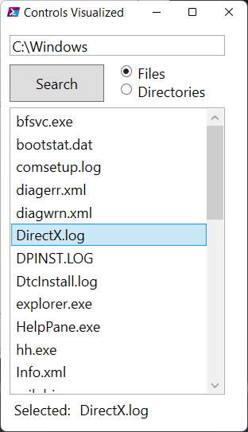
XAML Based Data Binding
Allows binding existing GUI elements together without PowerShell code
ElementName X:Name of XAML control to bind to
Path Property name of control to bind to
Mode One direction Two directions
<ListBox x:Name="DisplayListBox"…/>
<Label
Content="{Binding ElementName=DisplayListBox, Path=SelectedItem, Mode=OneWay}"
…/>
Notes:
https://learn.microsoft.com/en-us/dotnet/api/system.windows.data.binding?redirectedfrom=MSDN&view=windowsdesktop-7.0

Slide 45
PowerShell Based Data Binding
Displays on form refresh
Form not refreshed automatically with all datatypes
# Create a datacontext for the textbox and set it
$DataContext = New-Object
System.Collections.ObjectModel.ObservableCollection[Object]
$DataContext.Add((get-date -f HH:mm:ss))
$Gui.timebox.DataContext = $DataContext
# Create the binding information
$Binding = New-Object System.Windows.Data.Binding
$Binding.Path = "[0]"
$Binding.Mode = [System.Windows.Data.BindingMode]::OneWay
# Set the binding on the textbox
[void][System.Windows.Data.BindingOperations]::SetBinding($Gui.timebox,
[System.Windows.Controls.TextBox]::TextProperty, $Binding)
Notes:
The “text” property of $Gui.timebox will be bound to $DataContext PS variable. The source object always needs to be in the form of a Collection , List, Array kind of variable.

Slide 46
Demonstration
Data Binding

Slide 47
Questions?

Slide 48
Common Issues

Slide 49
Unresponsive GUIs
PowerShell code and GUI form refresh share the same thread
While PowerShell code is executing, the form will not respond
Runspaces
Events
Several techniques exist to make this code asynchronous, but they all have challenges:
Timers

Slide 50
GUIs & Runspaces
Easiest solution
Common Challenges
Updating the GUI:
Poor performance likely
Leverage a combination of synchronized hash tables, dispatchers, and events
Not covered in this workshop
Execute code blocks in a separate runspace where the output will be outside of the GUI
EndInvoke() will lock up the GUI, so waiting for the runspace the usual way is not a solution
$GUI = [hashtable]::Synchronized(@{})

Slide 51
Demonstration
Advanced Techniques

Slide 52
Questions?

Slide 53

PowerShell Graphical User Interfaces

Slide 54
Microsoft

Slide 55
Creating Timers - Example
$rawform.add_sourceinitialized({
#create timer object
$timer = new-object System.Windows.Threading.DispatcherTimer
$timer.interval = [timespan]"0:0:1"
#add event per tick
$timer.add_tick({
$DataContext[0] = get-date -f HH:mm:ss
})
$timer.start()
})
Notes:
The Timer itself does not prevent locks of the GUI but it can be used to update the form in between long running tasks or support a runspace to update the form thread itself while the runspace is processing the data.

